Slide 1
Group No 6-Ride Sharing Application
Team Members:
1) Simran – 191627101
2) Deepti – 191627080
3) Akarsh – 191627002
4) Navya -191627100
Notes:
Provide the tasks performed by individual Member here.
Member 1 –
Member 2 -
Member 3 -
Member 4 -

Slide 2
Ride Sharing Application
This Application facilitates ride-sharing by giving users a choice to either offer or find rides.
In simple terms, carpooling/ride-sharing refers to sharing empty seats in a vehicle. People commuting from one point to another can share empty seats with other passengers who are travelling on the same route.
When the application is launched, the user gets to make an account and pick to either offer a ride or take a ride.
A ride taker gets to share empty seats in ride giver’s vehicle and has a comfortable commute.
If he wants to take a ride, he can enter his PickUp Address and Drop Address, once the Identity Proof is Verified, a list of Available Ride Givers will be sent, once selected, the Ride Giver's Details will be sent.
A ride giver reduces his/her commuting costs by sharing fuel expenses with other passengers.
If he wants to offer a ride, he can enter the StartAddress and EndAddress, once the Driving license is verified, he will get a list of Ride Takers to confirm, once confirmed, the Ride Taker's Details will be sent.
Notes:
Survey details in this slide.
Detailed information can kept here (in Notes section).
This page can be duplicated.

Slide 3
Once the user creates an account, he can view his
-Profile: with details like Name, Picture, PhoneNo and emailID, along with a list of Identity Proofs(Driving License, Aadhar Card etc)
-Vehicles: to view his available vehicles
-Rides: with the history of rides along with payment details
-Ecometer: to view how much CO2 is being saved and in turn you save the world!!
A culture of carpooling within helps you save money, reduce Carbon Footprint by reducing the number of vehicles on road, help your employees network better, get to work happier, and find parking without any stress.

Slide 4
Use Case
Notes:
This slide and the next could be duplicated for more Use Cases.
Provide a Use Case number after # symbol and provide a description. In the next slide paste the Use case diagram generated by PlantUML.

Slide 5
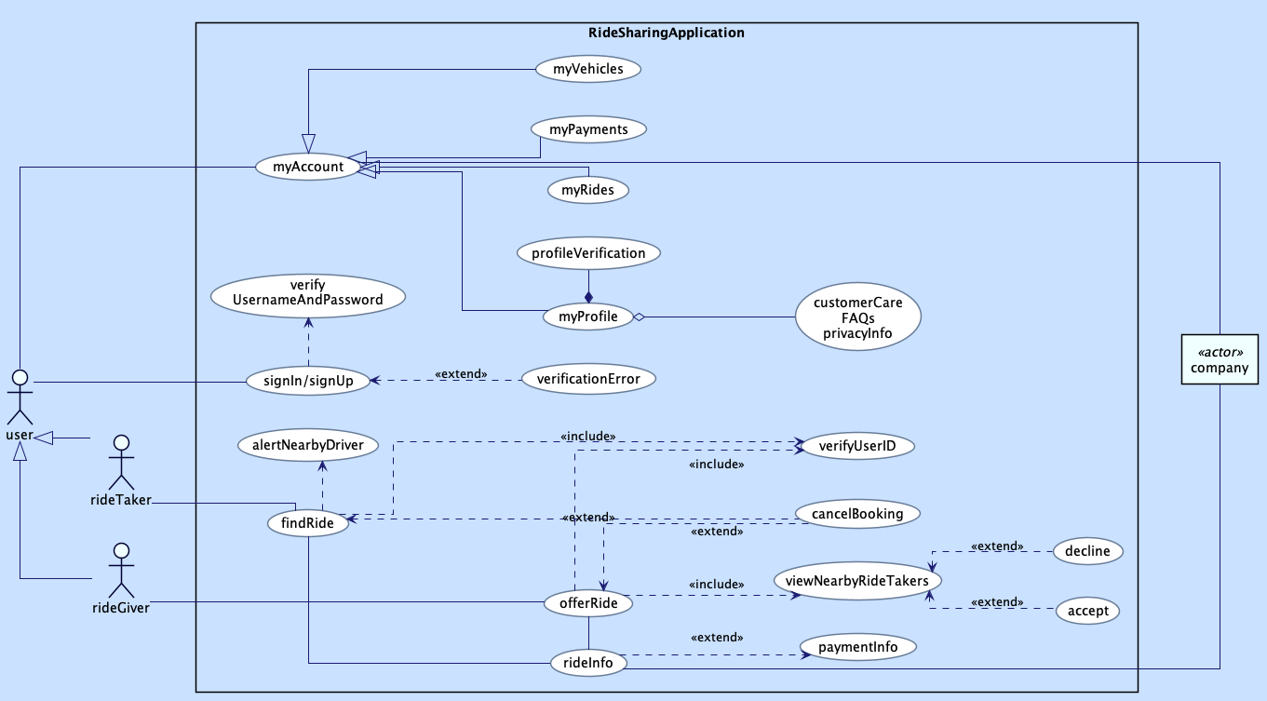
Notes:
Paste the Use case diagram generated by PlantUML here.
Slide no 3 and 4 could be duplicated for more use cases.
Paste the PlantUML code of the PlantUML diagram here.

Slide 6
Class diagram
Notes:
This slide could be duplicated for more Class Diagrams.
Provide a class diagram number after # symbol and provide a description and give the justification for the classes identified in the text section.
In the next slide paste the Class diagram generated by PlantUML.
You could also provide a domain model by duplicating this slide.

Slide 7
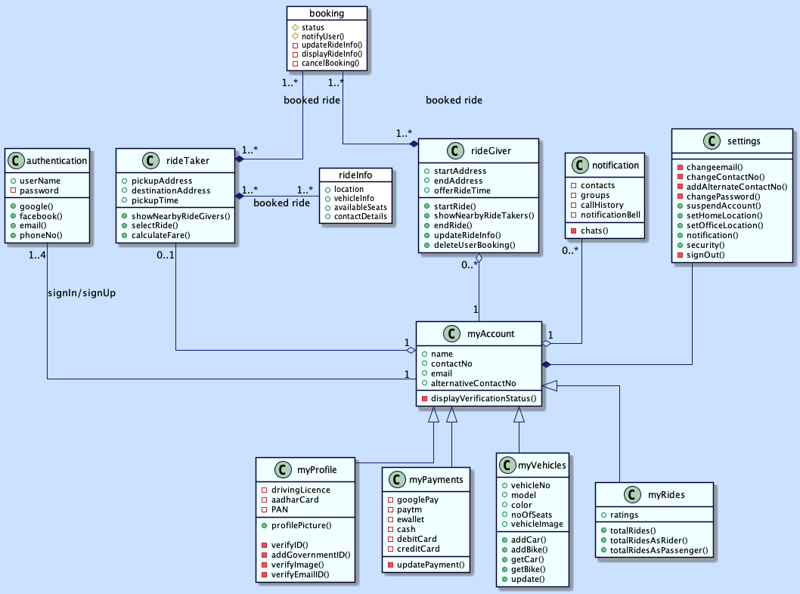
Notes:
Paste the Use case diagram generated by PlantUML here. Slide no 5 and 6 could be duplicated for more Class diagrams.
Paste the code here (in the notes section).

Slide 8
Sequence diagram
Notes:
This slide could be duplicated for more Sequence Diagrams.
Provide a description and give the justification for the sequence identified in the text section.
In the next slide paste the Sequence diagram generated by PlantUML.

Slide 9
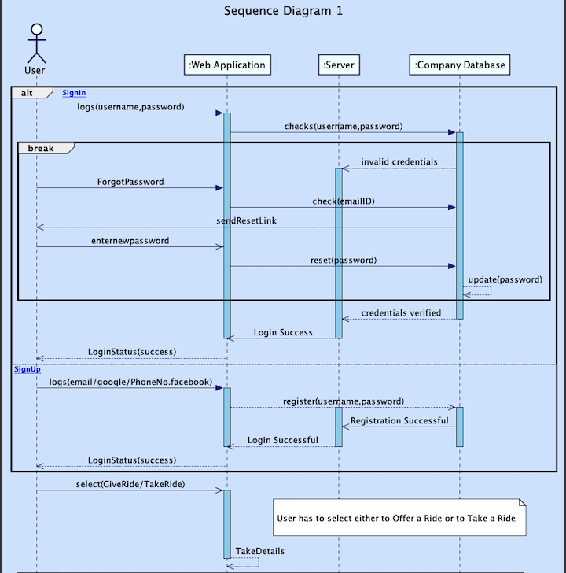
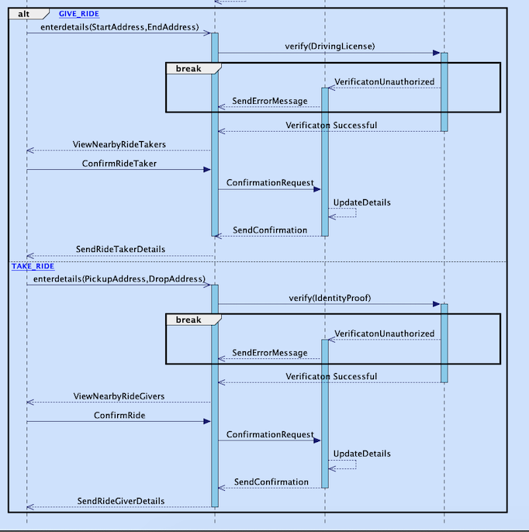
Sequence diagram #1
Notes:
Paste the Sequence diagram #1 generated by PlantUML here. Slide no 7 and 8 could be duplicated for more sequence diagrams.
Paste the code of sequence diagram here (in the notes section).

Slide 10
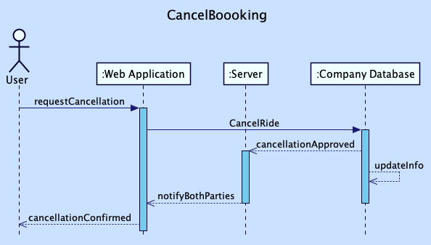
Sequence diagram #2

Slide 11
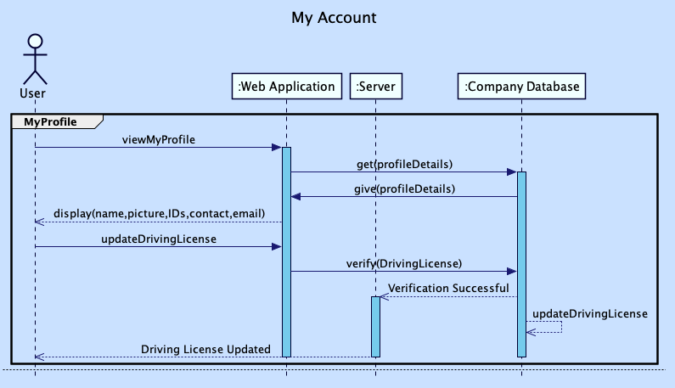
Sequence diagram #3

Slide 12
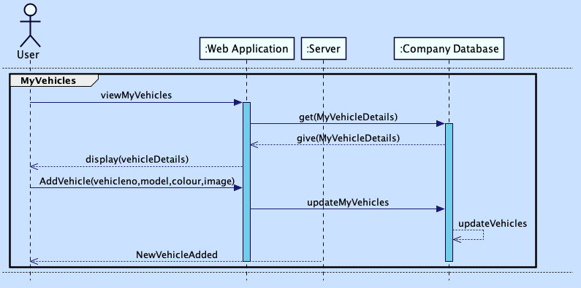

Slide 13
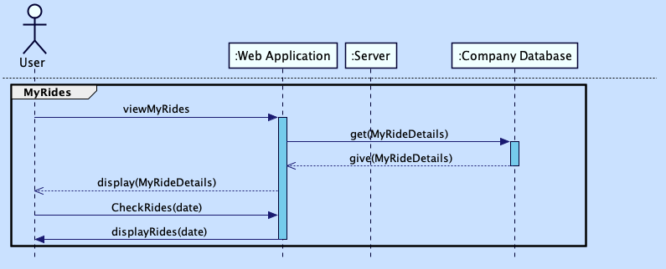

Slide 14
Activity diagram #1
Notes:
This slide could be duplicated for more Activity Diagrams.
Provide a description and give the justification for the activity identified in the text section.
In the next slide paste the Activity diagram generated by PlantUML.

Slide 15
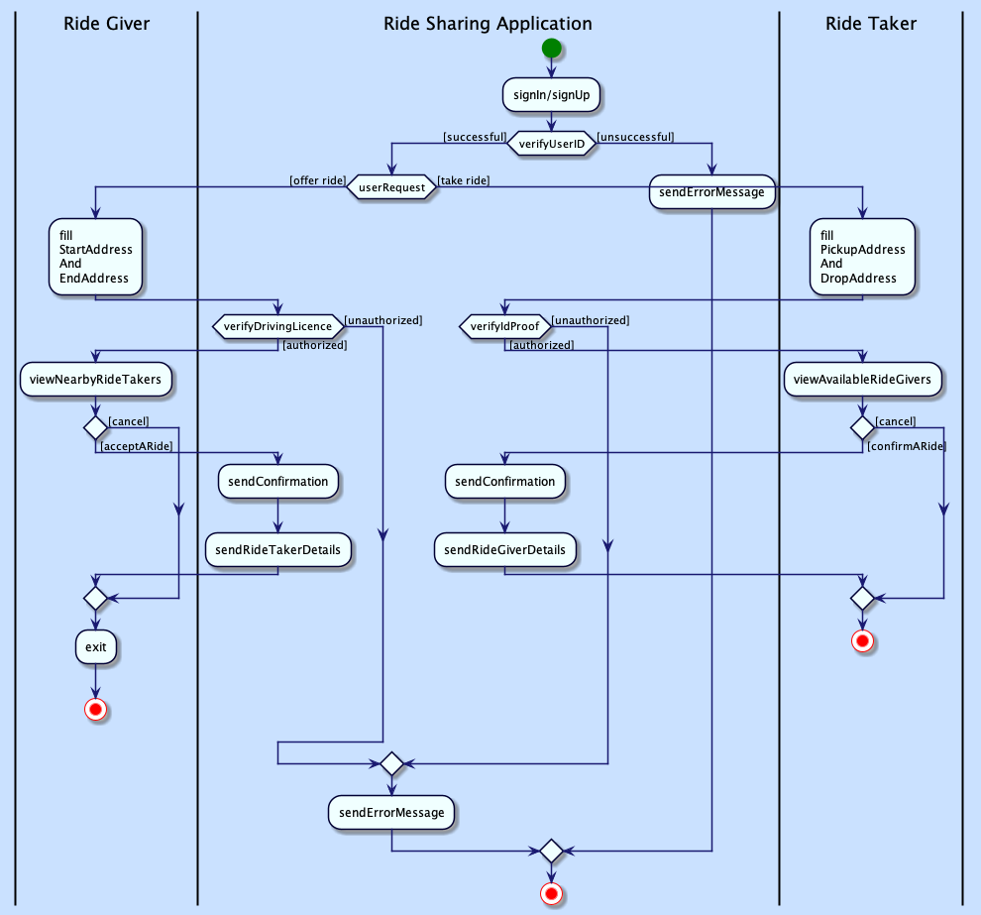
Notes:
Paste the Activity diagram #1 generated by PlantUML here. Slide no 9 and 10 could be duplicated for more activity diagrams.
Paste the code of activity diagram here (in the notes section).

Slide 16
State diagram #1
Notes:
This slide could be duplicated for more State Diagrams.
Provide a description and give the justification for the state identified in the text section.
In the next slide paste the State diagram generated by PlantUML.

Slide 17
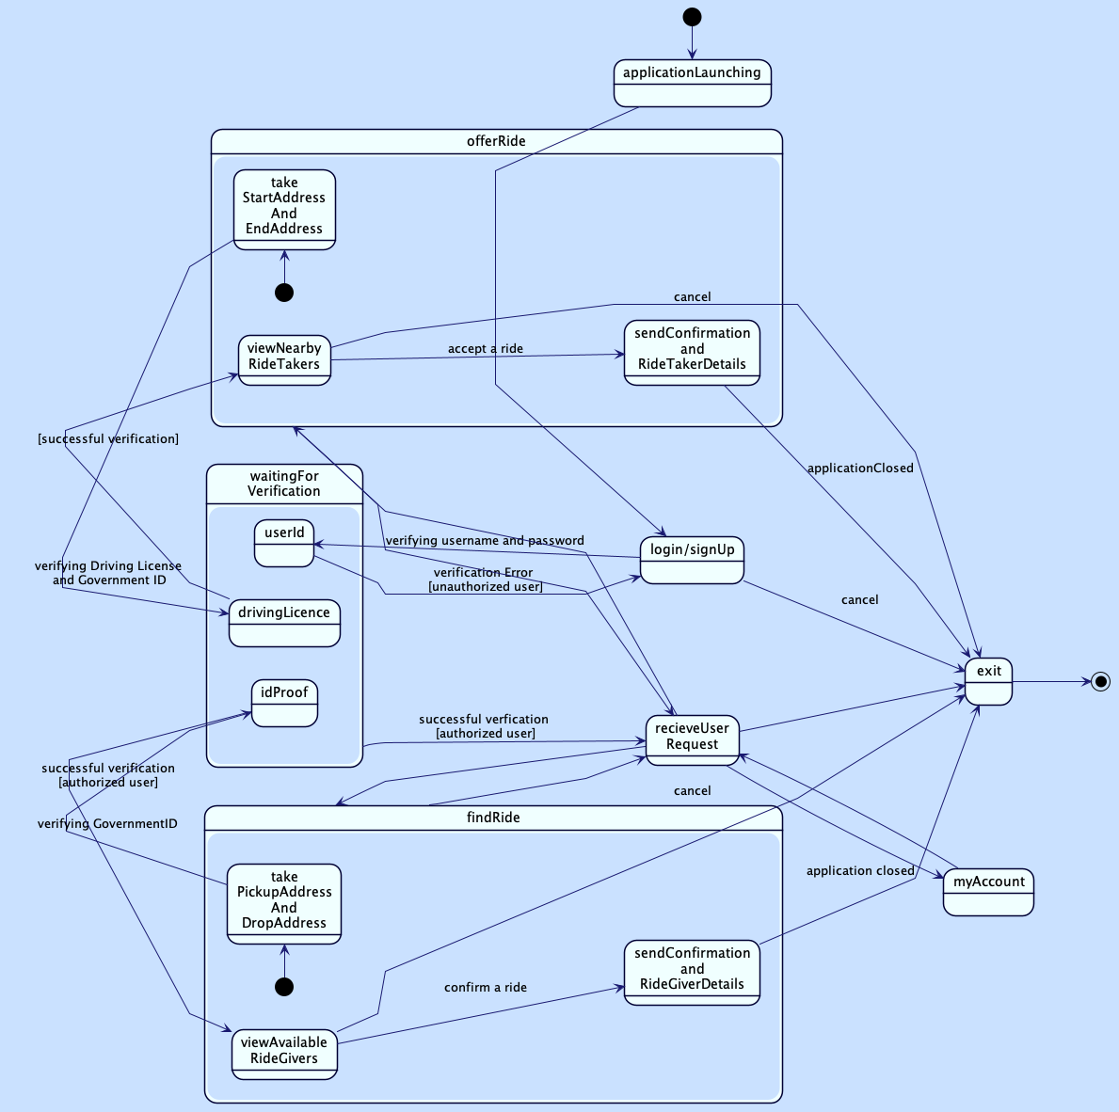
Notes:
Paste the state diagram #1 generated by PlantUML here. Slide no 11 and 12 could be duplicated for more activity diagrams.
Paste the code of state diagram here (in the notes section).

Slide 18
Component diagram
Notes:
This slide could be duplicated for more Component Diagrams.
Provide a description and give the justification for the state identified in the text section.
In the next slide paste the Component diagram generated by PlantUML.

Slide 19
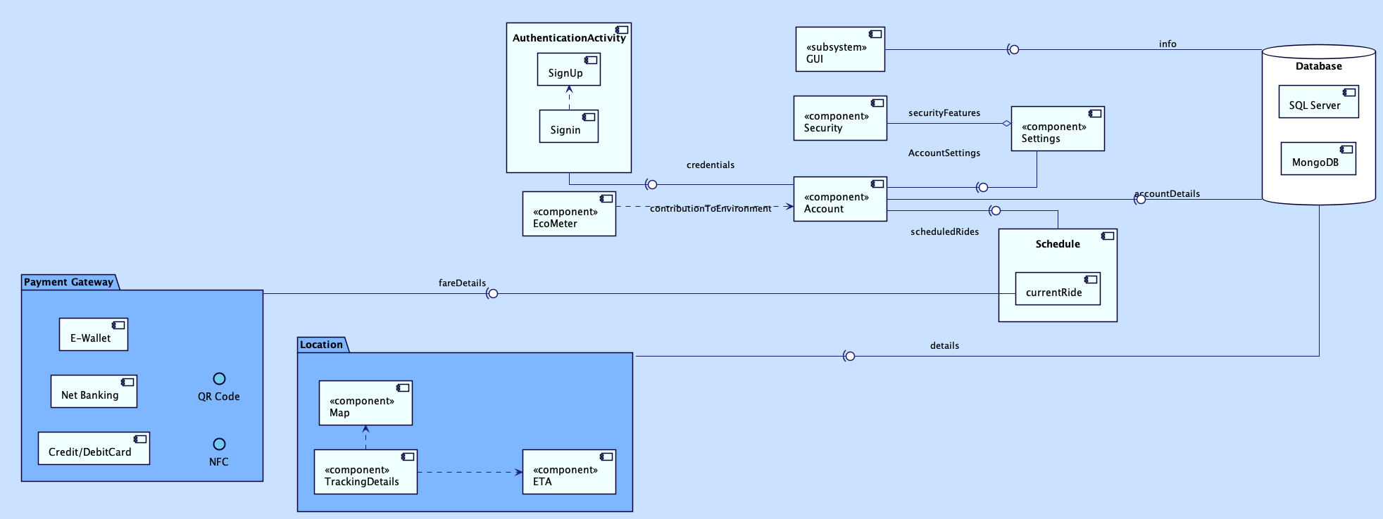
Notes:
Paste the Component diagram #1 generated by PlantUML here. Slide no 13 and 14 could be duplicated for more Component diagrams.
Paste the code of Component diagram here (in the notes section).

Slide 20
Deployment diagram
Notes:
This slide could be duplicated for more Deployment Diagram.
Provide a description and give the justification for the state identified in the text section.
In the next slide paste the Deployment diagram generated by PlantUML.

Slide 21
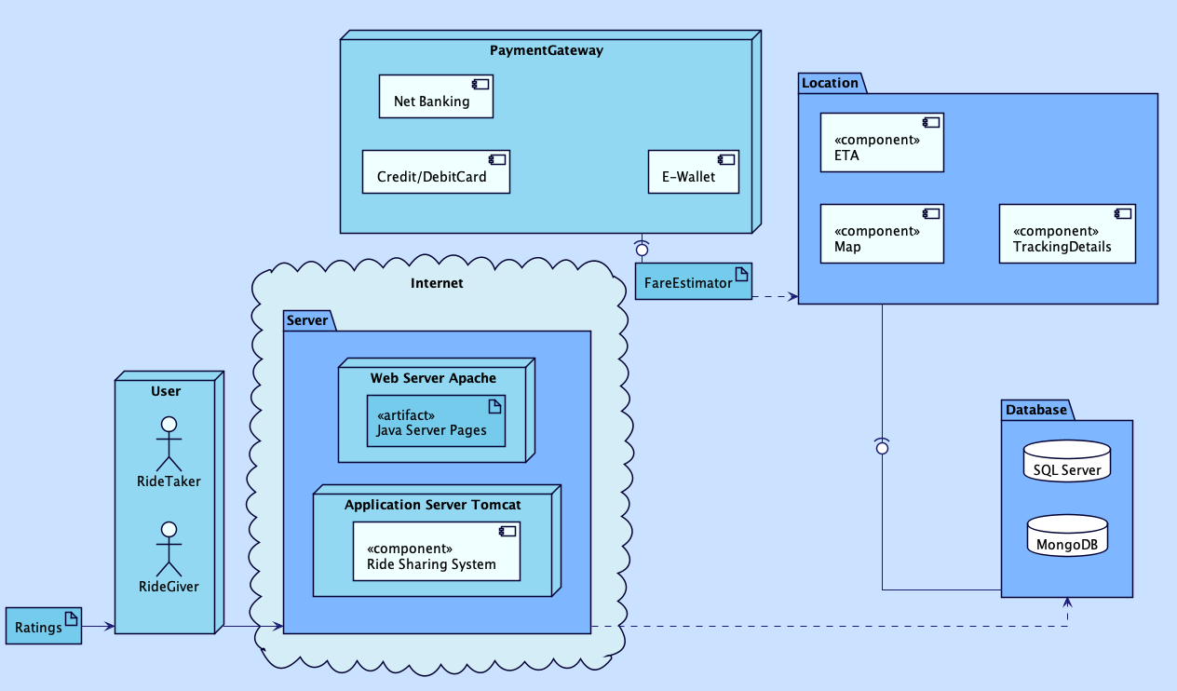
Notes:
Paste the Deployment diagram generated by PlantUML here. Slide no 15 and 16 could be duplicated for more Deployment diagrams.
Paste the code of Deployment diagram here (in the notes section).

